Slide 1

What Mental Health Consultation Services Look Like.
Early Childhood Training and Consultation
© Early Childhood Training & Consultation Program, Justice Resource Institute.
Permission to use with credit given. Contact Stacey Gay, Program Director @ sgay@jri.org

Slide 2
IS YOUR CHILD CARE PROGRAM IN NEED OF SUPPORT?
Are your educators feeling worried/anxious?
Are there children who are displaying behaviors that challenge or are in need of social/emotional support?
Are there children at risk of suspension or expulsion?
If so, submit a referral to the Early Childhood Training & Consultation Program at JRI so that we can provide support to you and your program.

Slide 3
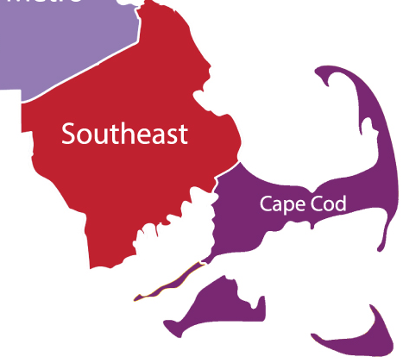

Early Childhood Mental Health Consultation
(ECMHC)
Our program covers Region 5, including 69 cities and towns in Southeastern Massachusetts, the Cape & the Islands.
This ECMHC program is grant funded by the Department of Early Education and Care.
There is no charge for the service.

Slide 4
EARLY CHILDHOOD MENTAL HEALTH CONSULTATION (ECMHC)
The Early Childhood Training and Consultation (ECTC) program is comprised of a multi-disciplinary team of early childhood, mental health, and education professionals who partner with childcare programs and families to support the healthy development of young children, particularly those who are emotionally, behaviorally or developmentally at-risk.
Early Childhood Mental Health Consultants form collaborative relationships with educators and families to work together to build the capacity of the early childhood staff to address and/or prevent challenging behaviors and foster social-emotional development. Consultants will help support the program to work with families to ensure continuity to build social emotional skills at the program and at the home for the child.
Consultants work alongside educators in their classroom setting to share strategies and model evidence-based interventions, facilitate referrals as needed and promote a deeper understanding of the factors that effect children’s social-emotional development.

Slide 5
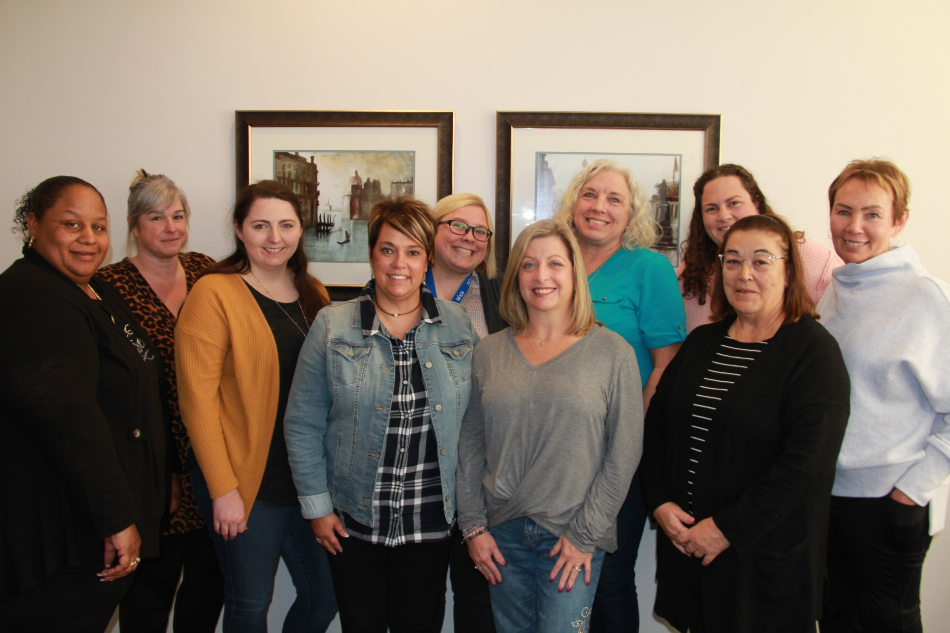
THE PROCESS
Referrals for therapies, special instruction, evaluations and other direct treatments are made if needed.
Early Childhood Mental Health Consultation intervenes to provide targeted social-emotional supports and individualized behavior interventions to address concerns about a specific child, classroom or program.
Parent/Caregiver consent is needed for this level of service for an individual child referral.
Specialized inclusive strategies designed to provide universal behavior support to all children in the classroom. These strategies can mitigate behavior concerns and are the foundation that must be in place for successful behavior Intervention.
Who?
Parents/Caregiver
Who?
Educators,
Program Staff & Parents/Caregiver
JRI's Early Childhood Training & Consultation Team
Who?
Educators & Program Staff
What is Early Childhood
Mental Health Consultation?

Slide 6


STEP ONE:
The Referral
EARLY CHILDHOOD TRAINING & CONSULTATION PROGRAM
Please email FY26 Referral Form and Consent to Receive Services Forms to ECTC Program Director, Stacey Gay- Sgay@jri.org and Early Childhood Coordinator, Lakia Small- Lsmall@jri.org.
Referrals can be for an individual child, a classroom or the program. Types of programs include: Center-Based Programs, Family Child Care Programs (FCCs), Public Preschool and Out of School Time Programs.
  Referral Form and Consent to Receive Services Form can be found on the JRI.org website under SERVICES.
  Then click on FOSTER CARE AND CHILDHOOD SERVICE
  Then click on EARLY CHILDHOOD TRAINING & CONSULTATION
  LINK https://jri.org/services/foster-adoption-ecs/early-childhood-training

Slide 7

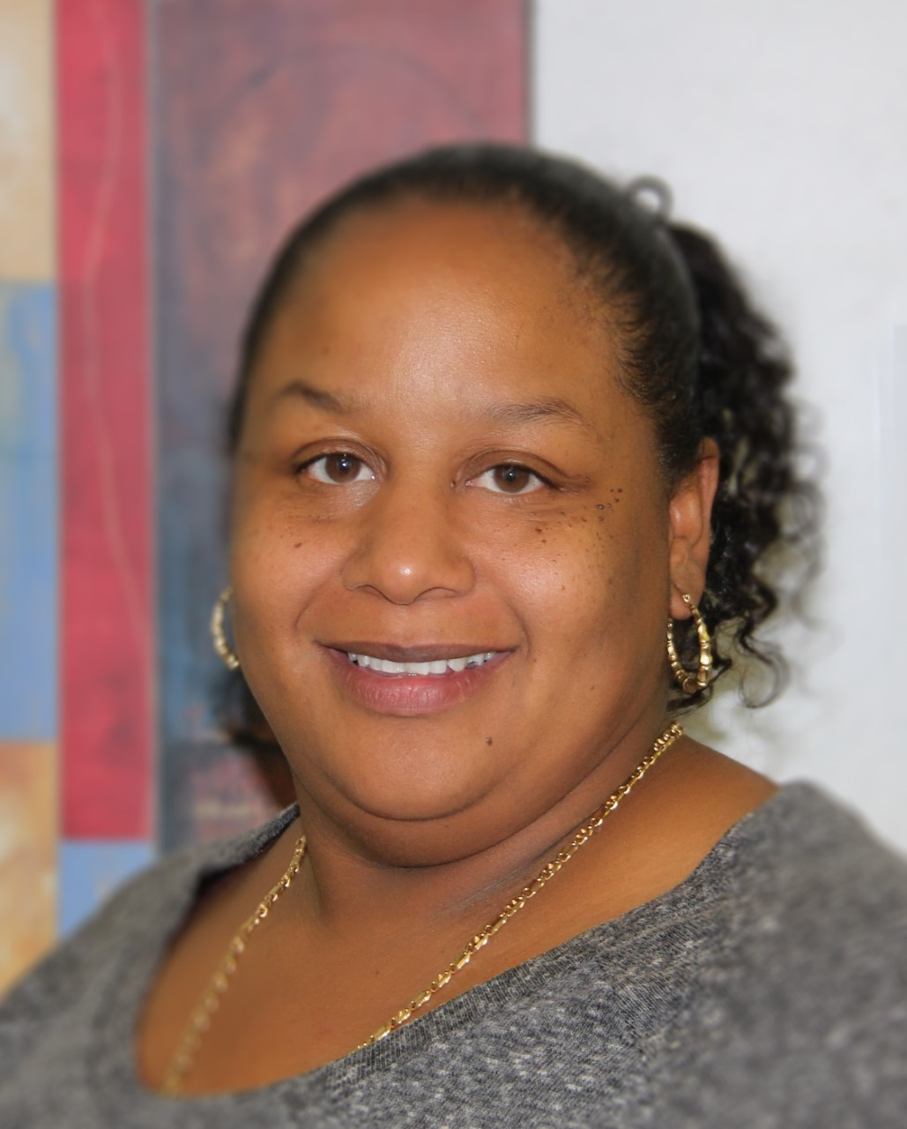
STEP TWO:
Follow-Up Call & Intake
The ECTC Program Director or Early Childhood Coordinator will attempt to contact the Center Director within 24 - 48 business hours of receiving the Referral to complete the intake process.
We will explore the ability to provide consultation services and the program’s technology capabilities.
Once the intake process is completed, an Early Childhood Consultant will be assigned so that services can start.
The Early Childhood Consultant will contact the Center Director to schedule an appointment.
Stacey Gay
Lakia Small

Slide 8


STEP THREE:
Consultation
The Early Childhood Consultant will talk with the Center Director and Educators to understand the needs and concerns.
The Early Childhood Consultant will complete or update the annual Service Delivery Plan and the annual Partnership Agreement with the Center Director.
The Early Childhood Consultant will schedule the observations and consultations.
We provide observations in person and meetings in person or virtually. Meetings are not recorded.

Slide 9

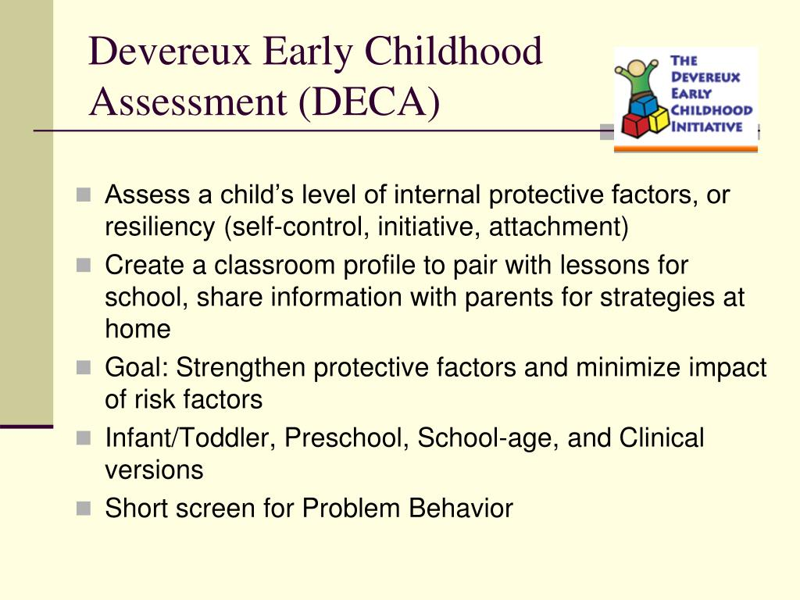
STEP FOUR:
Assessment
The DECA I/T, DECA-C or DESSA ASSESSMENT Forms will need to be completed by:
  Educator and Family
We can provide paper copies or email versions. We are also available to ask the questions over the telephone if needed.
Once the assessment tool is completed, the Early Childhood Consultant will score the assessment tool.
A Pre-DECA I/T, DECA-C or DESSA is completed at the beginning of the consultation services. A Post assessment is completed later.

Slide 10
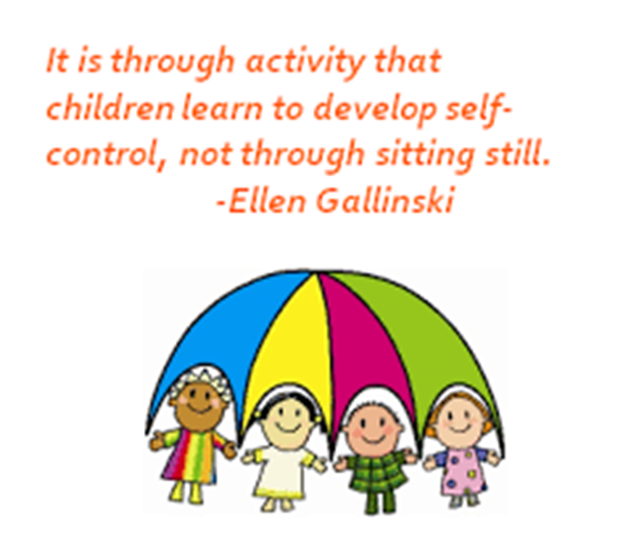

  STEP FIVE:
  Behavior Observation Report
A Behavior Observation Report is written after the Early Childhood Consultant has consulted with the Center Director and educators and observed the classroom.
The Early Childhood Consultant will utilize a Teaching Pyramid Observation Tool (TPOT or TPITOS).
The following items will be needed to complete the report: teacher feedback forms, teacher checklists, and the assessments.
Typically 2-5 hours of consultation and observation time are provided prior to writing the report.

Slide 11



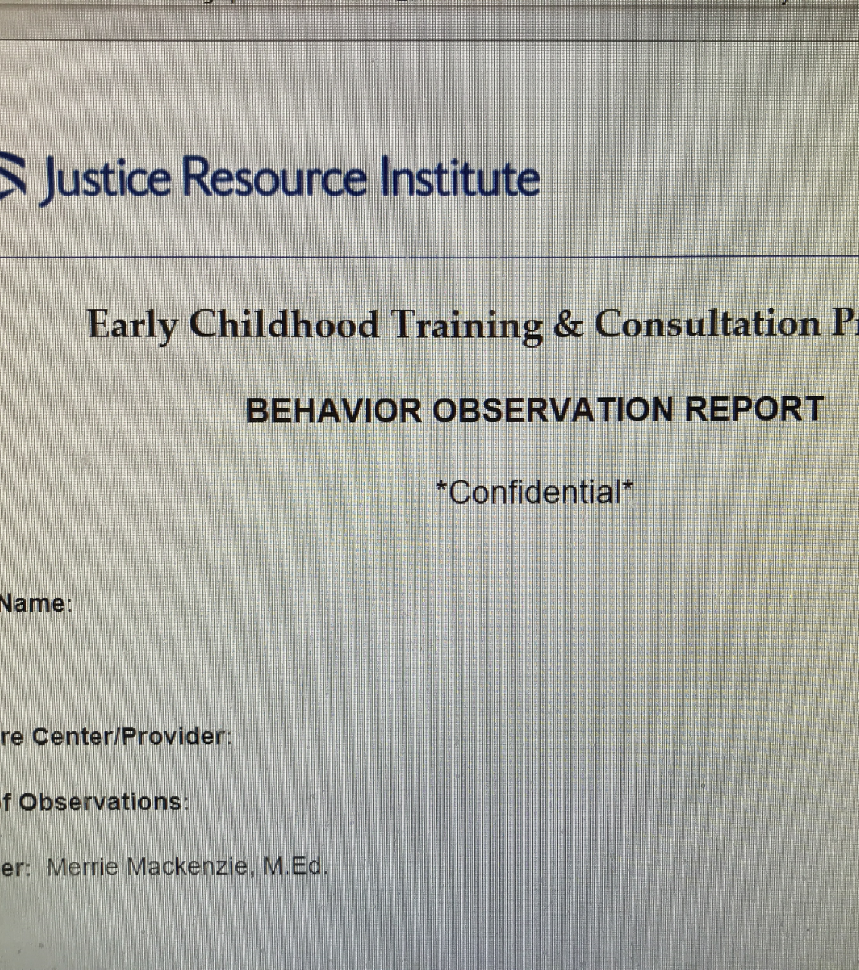

STEP SIX:
Behavior Observation Report is reviewed with Educator, Center Director and Family. This can be virtual or in person.

Slide 12
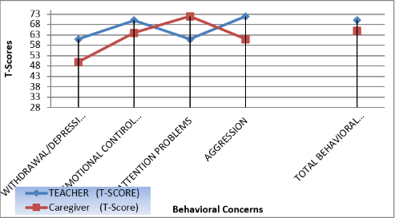
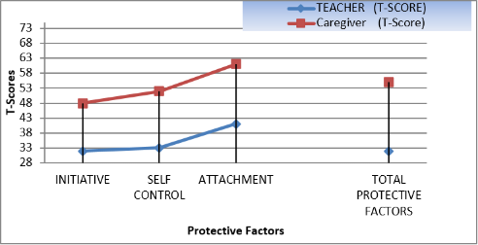
We will review the DECA I/T,
DECA-C or DESSA Assessment Tool Results with the Family and Teacher
Included in STEP SIX:

Slide 13

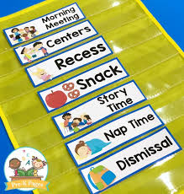
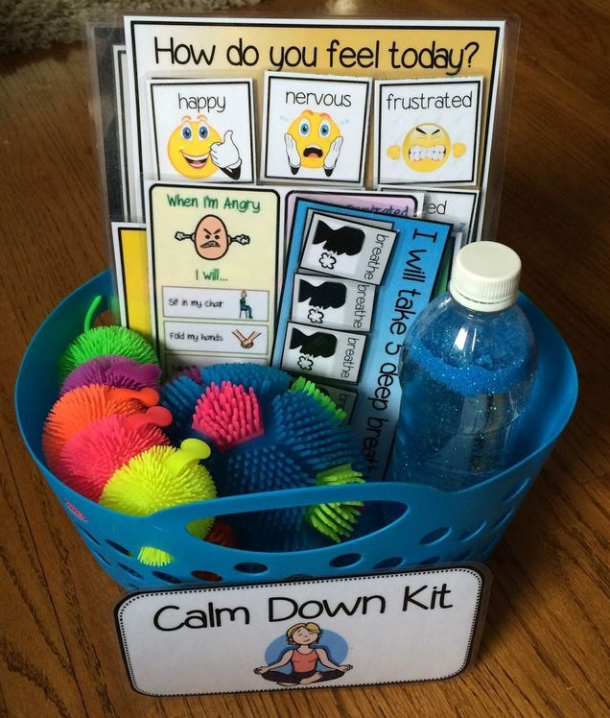
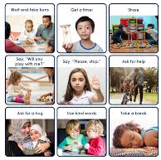
STEP SEVEN:
Action Plan
IDENTIFY EDUCATOR GOALS.
IDENTIFY STRATEGIES AND TOOLS TO USE TO SUPPORT TEACHER AND CHILD IN THE CLASSROOM.
MODEL HOW TO USE THE STRATEGIES IF NEEDED.
PROVIDE RESOURCES AND HELP MAKE REFERRALS IF NEEDED.
IDENTIFY PROGRAM NEEDS/GOALS AND OPPORTUNITIES FOR PROFESSIONAL DEVELOPMENT TO HELP BUILD SKILL CAPACITY.

Slide 14
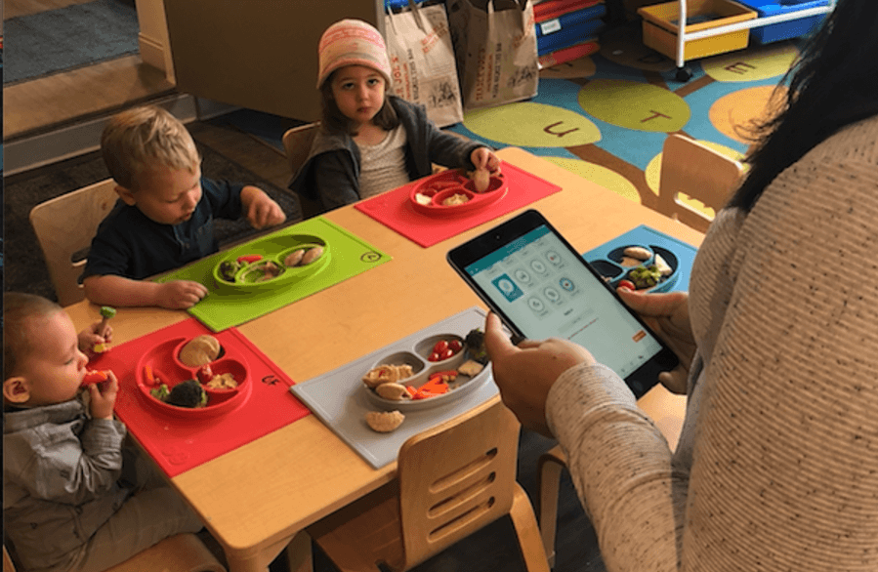


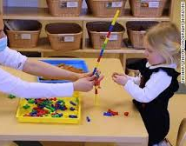

STEP EIGHT: Monitoring
We will maintain contact and be available to model how to use the recommended strategies/tools virtually to support adult/child dyad.
We will help the educators and Center Directors as they build supports and skill capacity into their program.
The average course of consultation services is 3-6 months, though more time may be requested based on need.

Slide 15

QUESTIONS?
Thank you!!!
Contact Stacey Gay, Program Director, Early Childhood Training & Consultation @ sgay@jri.org

